Slide 1
AIND Udacity

Slide 2
Reference
Artificial Intelligence – A Modern Approach
Korf, 1991, Multi-player alpha-beta pruning (for multiple players isolation)

Slide 3
Introduction
What is an intelligent?
One that takes actions to maximize its expected utility given a desires goal.

Slide 4
Agent, Environment and State (& goal state)
Perception
an agent interacts with the environment by sensing its properties.
Cognition
the process by which an agent decides what action to take based on its perceived inputs.
Environment state:
Fully observable vs Partially observable
Deterministic (know for sure the result of the action) vs Stochastic
Discrete (finite number of state) vs Continuous
Benign (the agent is the only one taking actions) vs Adversarial

Slide 5
Game

Slide 6
Sudoku

Slide 7
Isolation

Slide 8
Isolation
Building a game tree, opening book
Number of nodes in a game tree: b^d
b: the average branching factor (branching factor = 分支)
d: the depth of the game tree
In a 5*5 isolation: the average branching factor=8

Slide 9
Isolation
Mini Max Algorithm:
Find the best move.
bottom to top
大小大小選
For game playing
Evaluation Function:
Number my move for convenience.
Improve evaluation function -> #my moves-#opponents moves (#my moves – 2 * #opponents moves)
Depth limited search:
The whole point of limiting the depth of our search and using an evaluation function is to avoid the exponential explosion in the number of nodes we have to examine.
Quiescent Search:
with quiescence search we have to search the game three for two levels and maybe a whole lot more if the results are changing between levels. -> don’t have to use quiescence search all the time.
Iterative deepening:
從level1開始search (evaluation function)，若在時間內，則記下目前最好的，再開始search level 2，直到run out of time
b=k, n(nodes) = ((k^(d+1)) -1)/(k-1)
Always has an answer ready in case it runs out of time and it can search as far as possible within its time constraints

Slide 10
Isolation
Horizon Effect:
The game will be decided in the next move, but that the computer player cannot search far enough into the future to figure out the problem.
Alpha-beta pruning
A pruning technique that allows us to ignore whole sections of the game tree, but still get the same answer as with minimax.
Never change the answer, but much more efficient than minimax.
Others
Partition + alpha-beta + symmetry
When player1 first move is center, and then can always reflect player 2’s move, then player1 will always win

Slide 11
Other Isolations
Multiple Players Isolation:
Max N: can work for multiple games with any numbers of players.
Sloppy Isolation:
- Expectimax: In general, with Expectimax, you can only prune when you have know bounds on the values that will be returned by the Expectimax function.

Slide 12
n - Queens

Slide 13
n-Queens
Simulated annealing to solve

Slide 14
Sliding Blocks Puzzle

Slide 15
Sliding Blocks Puzzle
h1: # of misplaced blocks
h2: sum(distance of blocks)
h1 is admissible: every tile in the wrong position must be moved at least once to get in the right position.
h2 is admissible: every tile in the wrong position can be moved at least once to get in the right position. No faster than one space per move.
h2 always >= h1.

Slide 16
Rubik’s Cube

Slide 17
Rubik’s Cube
-> Iterative deepening A*

Slide 18
Technique

Slide 19
Powerful technique in AI
Search
Pick a box with a minimal number of possible values. Try to solve each of the puzzles obtained by choosing each of these values, recursively.
AI: Do what we do not know (traditional programming: do what we know), and Search is the key area to figure out.
Constraint Propagation
All about using local constraints in a space to dramatically reduce the search space.

Slide 20
Search

Slide 21
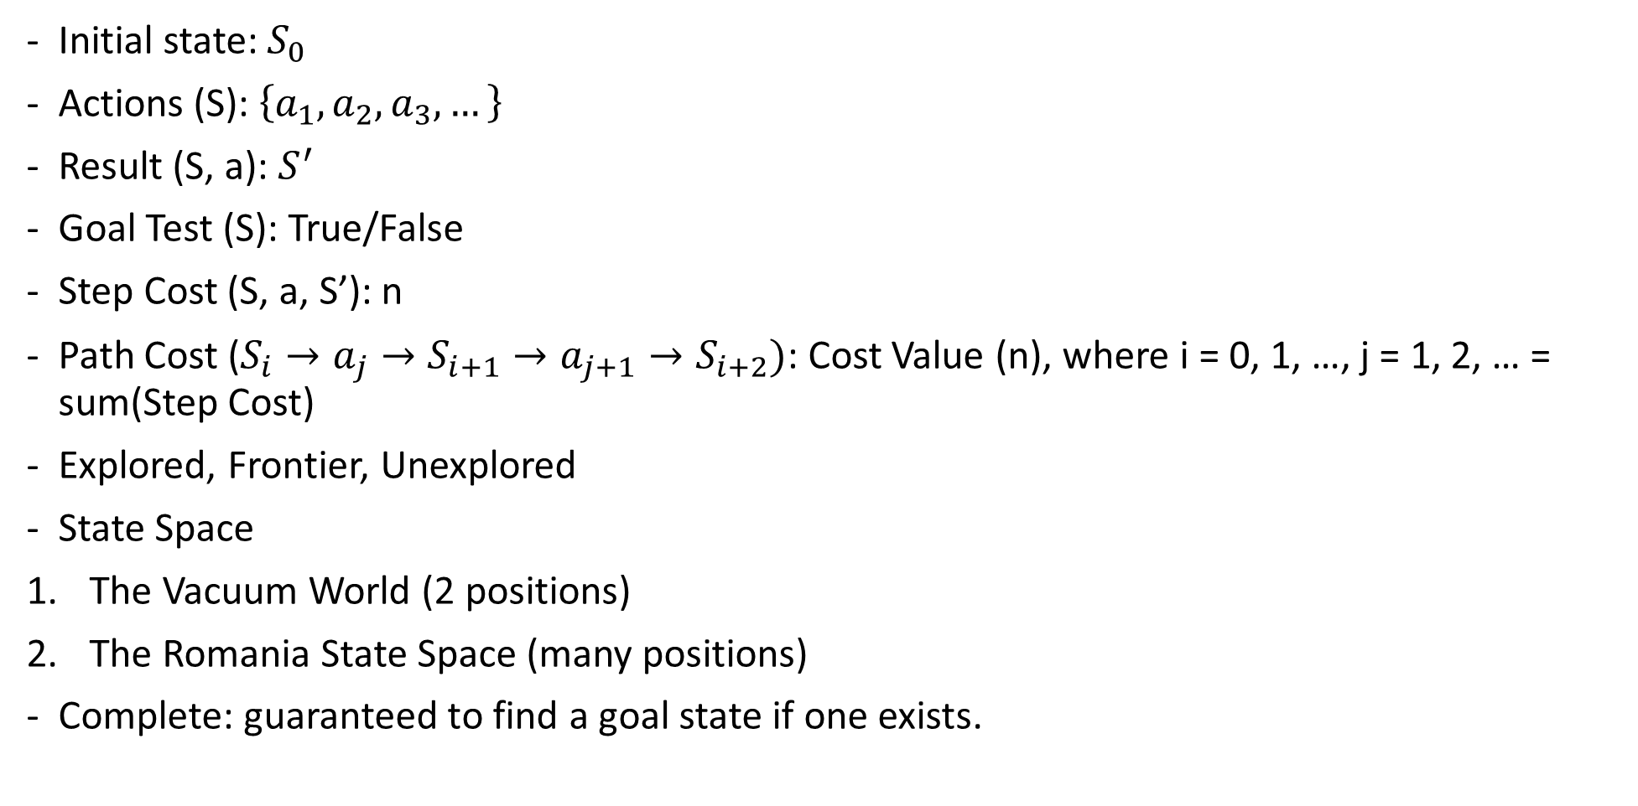
Search – Definition of a problem
Initial state: $S_{0}$
Actions (S): $\left\{a_{1}, a_{2}, a_{3}, …\right\}$
Result (S, a): $S^{′}$
Goal Test (S): True/False
Step Cost (S, a, S’): n
Path Cost ($S_{i}→a_{j}→S_{i+1}→a_{j+1}→S_{i+2})$: Cost Value (n), where i = 0, 1, …, j = 1, 2, … = sum(Step Cost)
Explored, Frontier, Unexplored
State Space
The Vacuum World (2 positions)
The Romania State Space (many positions)
Complete: guaranteed to find a goal state if one exists.

Slide 22
Search – Heuristic (啟發式)
Some additional piece of information – a rule, function or constraint – that informs an otherwise brute-force algorithm to act in a more optimal manner.
A heuristic h(n) is admissible (可採納的) if for every node n, h(n) <= h*(n), where h*(n) is the true cost to reach the goal state from n. -> an admissible heuristic never overestimates the cost to reach the goal, i.e., it is optimistic. e.g.

Slide 23
Search - Type
Avoid repeated path. (Don’t need to return to explored state)
Tree Search
Graph Search
Don’t hold a list of explored nodes.
策略為挑選節點展開的順序
Hold a list of explored nodes.
A node is selected for expansion based on an evaluation function that estimates cost to goal.
Uninformed Search
(Blind Search, Brute Force Search)
Informed Search
(Heuristic Search)
Estimate of the distance from start state to the goal. (Knowledge which is the most useful in search.)
Use only the information available in the problem definition.
Generates the search tree without using any domain specific knowledge.
type
1. Breadth First Search
(1) Uniform Cost Search
2. Depth First Search
(1) Depth Limited Search
(2) Iterative Deepening Search
3. Backwards Chaining
4. Bidirectional Search (雙向搜尋)
Be SMART about what path to try.
Use an evaluation function f(n) for node n.
不保證成功，但可大量節省時間。
type
1. Best First Search
(1) Greedy Best First Search
(2) A* Search
2. Memory Bounded Search
(1) Iterative deepening A* (IDA*)
(2) Recursive Best First Search
(3) Simplified Memory-Bounded A* (SMA*)
3. 疊代改進演算法
(1) Hill Climbing
(2) Simulated Annealing
Adversarial Search

Slide 24
Search – Uninformed Search
Breadth First Search 廣度優先搜尋法 (Shortest First Search)
從圖的某一節點(vertex, node)開始走訪，接著走訪此一節點所有相鄰且未拜訪過的節點，由走訪過的節點繼續進行先廣後深的搜尋。以樹(tree)來說即把同一深度(level)的節點走訪完，再繼續向下一個深度搜尋，直到找到目的節點或遍尋全部節點。
利用FIFO佇列(Queue)來處理，通常以迴圈的方式呈現。
A kind of graph search.
Complete.
No Optimality.
使用時機：Used when branching factor is small and shallow solutions exist.
步驟：
任意選擇某一個開始的節點，假設它為V0，因此先拜訪V0然後以任意的順序去拜訪V0的相鄰節點。
假設V0的相鄰節為V1，V2，…，Vi，當這些節點都拜訪過後，再接著拜訪V1的相鄰節點。
當V1相鄰節點都拜訪過後，再拜訪V2的相鄰節點，如此重覆直到圖形上的所有節點都被拜訪過。
Shortest step
Shortest cost
Uniform Cost Search 成本一致搜尋法 (Cheapest First Search)
Pick the path with the lowest total cost.

Slide 25
Search – Uninformed Search
Depth First Search 深度優先搜尋法 (longest path)
是一種用來遍尋一個樹(tree)或圖(graph)的演算法。由樹的根(或圖的某一點當成 根)來開始探尋，先探尋邊(edge)上未搜尋的一節點(vertex or node)，並儘可能深的搜索，直到該節點的所有邊上節點都已探尋；就回溯(backtracking)到前一個節點，重覆探尋未搜尋的節點，直到找到目 的節點或遍尋全部節點。
利用堆疊(Stack)來處理，通常以遞迴的方式呈現。
A kind of graph search.
Not complete.
步驟：
以縱向為先，首先選定一個任意節點，假設為V0，由拜訪V0開始。
V0的相鄰節點有V1，V2，…，Vi；然後拜訪V1，再拜訪V1的相鄰節點中的某一節點，如此一直重覆。
若其所有相鄰節點均已被拜訪過，則回到上一個被拜訪過的節點，它還含有未被拜訪過的相鄰節點Vp，就再拜訪Vp。

Slide 26
Search – informed Search
Best First Search
Greedy Best First Search 貪婪最佳優先搜尋法
- f(n) = h(n) = estimate of cost from n to goal
A* Search
Best estimated total path cost first
Minimum value f(n) = g(n) + h(n) = path length + estimated distance
g(path): path cost
h(path)=h(s): estimated (straight line) distance to goal
A* finds the lowest cost path if h(s) < true cost. It depends on the h function.
f
G
S
X
h: estimated distance
g: path cost so far
Result: Search strategy that is the best possible finds the shortest length path while expanding minimum number of paths possible.

Slide 27
Search – informed Search
碰上需要的記憶體太大的問題
Memory Bounded Search
Iterative deepening A*
Recursive Best First Search
Simplified Memory-Bounded A*

Slide 28
Search – informed Search
疊代改進演算法
主要的觀念就是在搜尋的過程中每次只記得現在目前這個點的狀況卻不記得以前走過哪些點了 , 就像在霧裡爬山一樣 , 我們只知到目前所在的位置而只能對周圍的點作探測來決定下一步要往周圍的那一點走 , 如此 , 我們所在的狀態以此方法不斷的更新直到目標點為止

Slide 29
Search – Adversarial Search

Slide 30
Search –
Mini-Max Algorithm: you are trying to maximize your chances of winning on your turn, and your opponent is trying to minimize your chances of winning on their turn.
Alpha-Beta pruning (help optimize algorithm)

Slide 31
Search - Problems
State Space might be so large that we need other techniques to search the space and find optimal solutions.

Slide 32
Find The Global Maximum

Slide 33
Random Restart

Slide 34
Local Beam Search (vs Stochastic Beam Search)
k particles
Select the best neighbor.
Once reach the goal, terminate.

Slide 35
Simulated Annealing
Problem (like hill climbing, Gradient Descent):
Stuck in local maximum, shoulder (step size too small), cross the optimum (step size too large).
一種Markov chain Monte carlo(馬可夫蒙地卡羅)的延伸。
Technique to navigate a potentially large space.
在固定時間內尋求在一個大的搜尋空間內找到的最優解。

Slide 36
Genetic Algorithms

Slide 37
Logic

Slide 38
Planning

